Slide 1
Project Management Review
Done by: G1T3

Slide 2
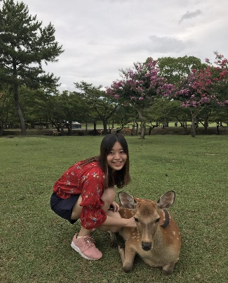
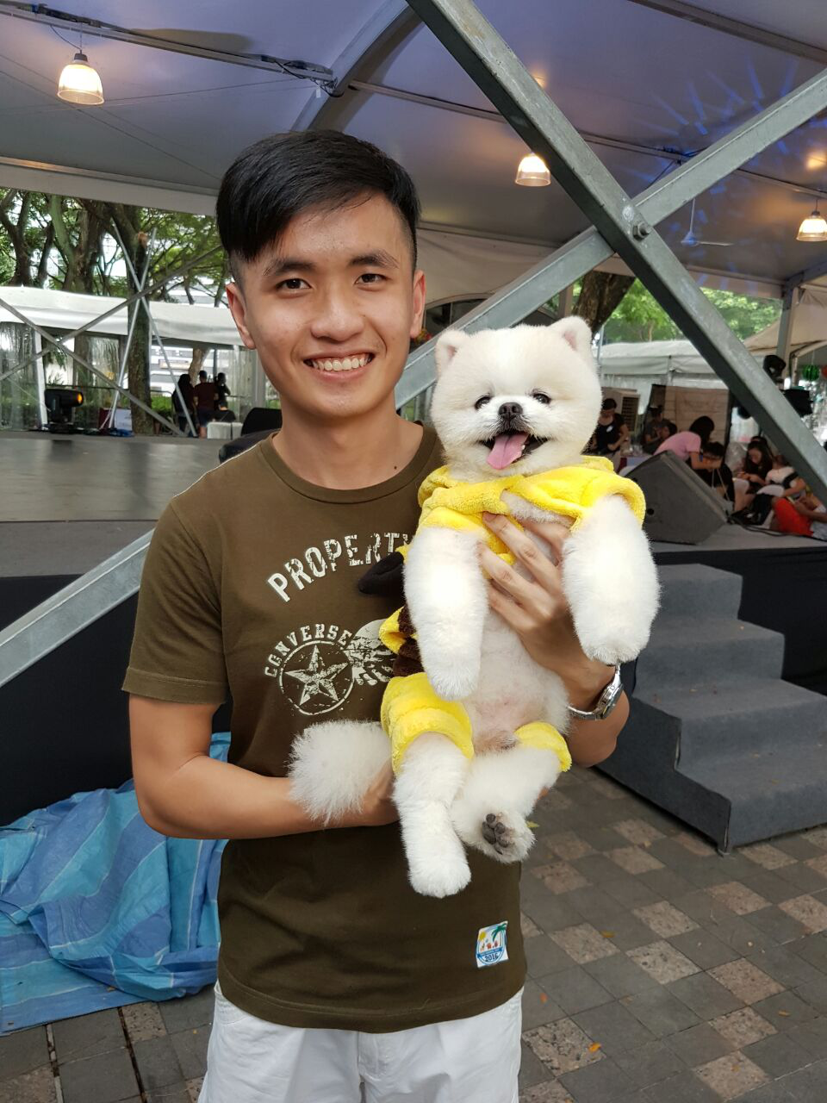
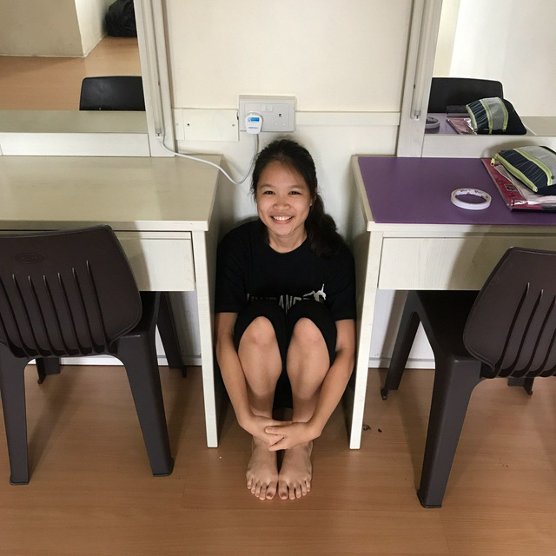
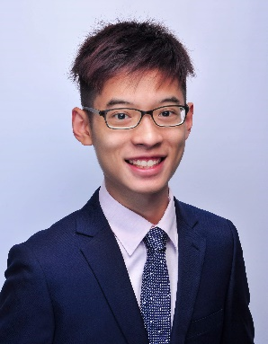

Joleen
Team NO S.I.S.
Amanda
Joel
Shreyas
Ming Xuan

Slide 3
Content page
Functionalities
Schedule
Metrics (schedule & bug)
Roles & responsibilities - Pair programming/rotation plan

Slide 4
1.Functionalities

Slide 5
Functionalities
Login
Bootstrap
Heatmap
Basic Location Report
Automatic Group Identification
Dual Interfaces (UI and Web Services)
Our group does not intend to drop any functionalities.

Slide 6
Do you plan to use any frameworks, or stick with MVC or JSP Model 1 or JSP only?
Chosen model: MVC
Benefits:
Individual pages would face less complexity
Lesser interaction between the UI and Java
Easier separation of roles for pair programming

Slide 7
2. Schedule

Slide 8
Iteration No | Week | Period | Start Date | End Date | Milestones
Iteration 1 | Week 2 Week 3 | 14 days | 29/08/2017 | 12/09/2017 | Planning Design Diagrams Design Metric
Iteration 2 | Week 4 Week 5 | 14 days | 13/09/2017 | 26/09/2017 | Login Authentication Bootstrap
Iteration 3 | Week 6 Week 7 | 14 days | 27/09/2017 | 10/10/2017 | Supervisor Meeting 1 Primary Functions Top k popular places report Student breakdown report Web UI PM Review AWS Deployment
Iteration 4 | Week 8 Week 9 | 14 days | 11/10/2017 | 24/10/2017 | Primary Functions Heat Map Automated Group Identification
Iteration 5 | Week 10 Week 11 | 14 days | 25/10/2017 | 07/11/2017 | Supervisor Meeting 2 Primary Functions Top k people report Top k next places Dual Interfaces Application Demo
Iteration 6 | Week 12 Week 13 | 14 days | 08/11/2017 | 21/11/2017 | UAT Submission
Iteration 7 | Week 14 | 1 day | 22/11/2017 | 22/11/2017 | Presentation

Slide 9
Broad Iteration
Iteration 1
Iteration 2
Iteration 3
Iteration 4
Iteration 5
Iteration 6
Iteration 7
Login
S.B. Report
A.G.I
Top K people report
UAT
Planning
Final Presentation
Top K Popular Place report
Top K next place report
Bootstrap Function
Heat Map
Submission

Slide 10
Iteration 1 Critical Path: 6 Days, Slack: 9 days
Planning
Design
Plan project broad schedule (1 day)
Test Plan Preparation (1 day)
Prepare metrics (2 days)
Create iteration breakdown (1 day)
Discussion on Project Requirements and team's project iterative approach
(1 day)
Create class diagram (1 day)
Functionalities breakdown and logic sketching
(1 day)
Create Login sequence diagrams (1 day)
Create database ER diagrams (1 day)
Create use case diagram (1 day)

Slide 11
Task Metric Result for Iteration 1
No. of Planned Tasks | Total no. of Tasks | Completed Tasks | Uncompleted Tasks
10 | 12 | 12 | 0
Result: 1.2

Slide 12
Iteration 2 Critical Path: 11 Days, Slack: 3 Day
Planning
Testing
Overall functions testing (1 day)
Create test cases (1 days)
Debug Login (1 day)
Debug Bootstrap (1 day)
Coding
Login Page (1 day)
DBConnection (1 day)
Home Page (1 day)
Validation Location look up (1 day)
Login Authentication (1 day)
Validation Location (1 day)
Validation Demographic ( 1 day)
Upload Page (1 day)
Upload Servlet (1 day)
Design
Create Bootstrap sequence diagrams (1 day)
Create Student Breakdown report sequence diagrams (1 day)
Create TOP K reports sequence diagrams (1 day)
Create HM sequence diagrams (1 day)
Create AGI sequence diagrams (1 day)

Slide 13
Task Metric Result for Iteration 2
No. of Planned Tasks | Total no. of Tasks | Completed Tasks | Uncompleted Tasks
18 | 20 | 15 | 5
Result: 0.83

Slide 14
Iteration 3 Critical Path: 10 Days, Slack: 4 days
Planning
Student breakdown request debugging (1 day)
Supervisor Meeting 1 (1 day)
PM Review (1 day)
Testing
Overall functions testing & debugging(1 day)
Top K place request debugging (1 day)
Create test cases (1 day)
PM Review Preparation (1 day)
Update test plan (1 day)
Integration
Coding
Integrate required functions with previous functions (1 day)
Create Top K DAO -
Top K places
(1 day)
UI Design (1 day)
Basic Location Report(Request, Servlet, Location DAO)
(1day)
Advanced breakdown 3 requests (1
day)
Deployment
Student breakdown request(Student, gender)(1day)
Student breakdown request(Schools)(1day)
Advanced breakdown 2 requests (1
day)
Deployment on AWS (1 day)

Slide 15
Updated Iteration 3 Critical Path: 9 Days, Slack: 5 days
Planning
Testing
Student breakdown request debugging (1 day)
Overall functions testing & debugging (1 day)
Supervisor Meeting 1 (1 day)
PM Review (1 day)
Bootstrap debugging (1 day)
PM Review Preparation; Creating Test cases, Update Test plan (1 day)
Integration
Coding
Integrate required functions with previous functions (1 day)
Validation Location Lookup(1day)
Advanced breakdown 3 requests (1
day)
Validation location(1 day)
Validation demographics(1day)
UI Design (1 day)
Develop JSON Authenticate
(1 days)
Deployment
Basic Location Report(Request, Servlet, Location DAO)
(1day)
Student breakdown request(Student, gender)(1day)
Student breakdown request(Schools)(1day)
Deployment on AWS (1 day)
Advanced breakdown 2 requests (1
day)

Slide 16
Iteration 4 Critical Path: 11 Days, Slack: 3 days
Planning
Testing
AGD Debugging
(1 days)
Overall functions testing & debugging (1 day)
Create test cases (1 day)
Testing after redeployment (1 day)
Heat Map Debugging
(1 days)
Update test plan (1 day)
Deployment
Coding
Heat Map Servlet
(2 days)
Develop JSON Student Breakdown report
(1 days)
Redeployment on AWS (1 day)
Heat Map Request Page
(1 day)
Heat Map Interface /UI
(1 days)
Heat Map DAO
(1 days)
Integration
AGD request Page
(1 day)
AGD Servlet
(1 day)
Integrate search classes with previous functions (1 day)
AGD DAO
(2 day)
AGD Interface
(1 day)

Slide 17
Iteration 5 Critical Path: 9 Days, Slack: 4 days
Planning
Deployment
Supervisor meeting 2 (1 day)
Redeployment on AWS (1 day)
Redeployment on AWS for UAT(1 day)
Demo of prototype and progress update (1 day)
Create test cases (1 day)
Testing
Update test plan (1 day)
Overall functions testing & debugging (1 day)
Testing after redeployment (1 day)
Coding
Update Top K DAO-
Top K next place report
(1 day)
Update Top K DAO –
Top K people report
(1 day)
Top K reports debug
(1 days)
Update basic location report Servlet (1 day)
Create Top K DAO -
Top K places
(1 day)
Integration
Develop JSON Heat Map
(1 days)
Develop JSON AGI
(1 days)
Develop JSON Top K
(1 days)
UI – Improve Usability
(1 days)
Integrate improved UI with previous functions (1 day)

Slide 18
Iteration 6 Critical Path: 8 Days, Buffer: 4 days
Planning
Design
Final Presentation Slides (1 day)
Manual UAT in class and automated UAT (1 day)
Integration
Integrate improved UI with previous functions (1 day)
Coding
Testing
Testing after redeployment (1 day)
Post- UAT Improve application (3 days)
Overall functions testing & debugging (1 day)
Enhance UI (3 days)
Deployment
Final Deployment on AWS (1 day)

Slide 19
Iteration 7 Critical Path: 2 Days
Planning
Final presentation rehearsal (1 day)
Final presentation (1 day)

Slide 20
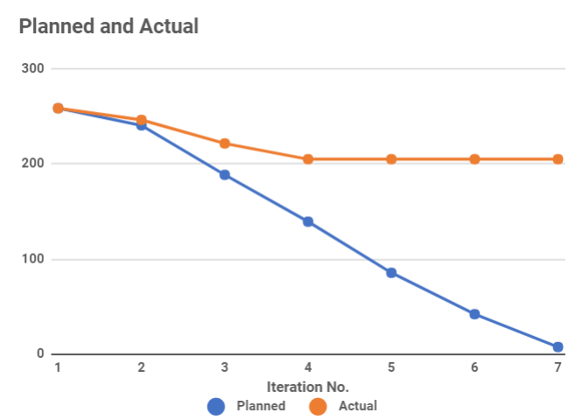
Burndown Report

Slide 21
Roles and Responsibilities - PM Milestones
Supervisor Meeting 1 (02/10/2017) – Amanda
PM Review (04/10/2017) – Amanda
AWS Deployment (07/10/2017) – Amanda
Supervisor Meeting 2 (24/10/2017) - Joleen
Application Demo and Progress Update (25/10/2017) – Joleen
UAT (8/11/2017) – Shreyas
Final Submission (19/11/2017) – Shreyas
Final Presentation (22/11/2017) – Joel

Slide 22
Task Distribution
Functions | Joel | Shreyas | Ming Xuan | Amanda | Joleen
Login Authentication |  |  |  | ✓ | ✓
Bootstrap | ✓ |  | ✓ | ✓
Validations of csv files | ✓ |  |  |  | ✓
Top K popular places report |  | ✓ | ✓
Student breakdown report |  | ✓ | ✓
Heat Map |  | ✓ |  |  | ✓
Automated Group Identification | ✓ | ✓ |  | ✓
Dual Interface | ✓ |  | ✓
Top k People report |  | ✓ |  | ✓
Top k next places report |  | ✓ |  | ✓ | ✓
UI – Develop |  | ✓ | ✓
UI – Improve Usability | ✓ |  | ✓
UI – Enhance |  |  |  | ✓ | ✓

Slide 23
3. Metrics

Slide 24
Task Metrics
Severity | Action
TM < 50 | Immediately, inform your supervisor about the slip within 24 hours. Then use the same mitigation as the category 50 < TM < 90 and seriously consider dropping tasks.
50 < TM <= 90 | Re-estimate the tasks for the future iterations. Deduct the number of days behind schedule from slack/buffer days. If there is no more slack/buffer day, decide the functionalities to drop.
90 < TM <= 110 | Our estimates are fairly accurate, and we are roughly on track. 1. Add/Deduct the number of days behind schedule from buffer days. 2. If there is no more buffer day, decide the functionalities to drop
110 < TM <= 150 | Gross over-estimated the effort required. 1. Re-estimate the tasks for the future iterations. 2. Add the number of days gained to buffer days.
150 < TM | 1. Immediately, inform your supervisor about the slip within 24 hours. 2. Then use the same mitigation as the category 110 < TM < 150

Slide 25
Task Metrics
(1, 1.2)
Iteration | Planned Tasks | Total Task | Task Completed | Task brought forward
1 | 10 | 12 | 12 | 0
2 | 18 | 20 | 15 | 5
3 | 22 | 23 | 8 ( as of now) | -
(2, 0.85)
TM
Score
(2, 0.5)
Iteration

Slide 26
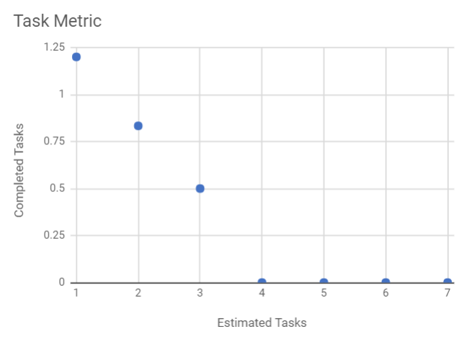
Task Metrics

Slide 27
Mitigation plan for iteration 3
Iteration | Task | Problem | Mitigation Plan
3 | Validation Location.csv | We were not as confident when we just started our coding for this project → we therefore had to spend more time researching. At the same time, as we were rusty with our sequence diagrams more time was spent. | Move tasks to slack If necessary, push tasks to the next iteration.
 | Validation Demographics.csv
 | Validation Location Lookup.csv
 | Debug Bootstrap

Slide 28
Bug Metrics
Iteration | No. of low impact bugs | No. of high impact bugs | No. of critical impact bugs | Total severity points | Bugs carried to next iteration
1 | 0 | 0 | 0 | 0 | 0
2 |  |  | 1 | 10 | 0
3 | 1 | 4 | 1 | 99 | - (still on going)

Slide 29
4. Roles & Responsibilities - Rotation Plan & Pair programming teams

Slide 30
Different roles
Project Manager
Programmer
Notetaker
Time keeper

Slide 31
Role: Project Manager
To help with:
Activity planning for each iterations
In charge of documentation
To monitor progress of the group

Slide 32
Role: Programmer
To help with:
Coding different functionalities
Testing, debugging
Integration
Deployment

Slide 33
Role: Notetaker
To help with:
Writing the minutes within 24 hours after meetings

Slide 34
Role: Time-keeper
To help with:
Ensuring that group is on task during meetings

Slide 35
Rotation Plan
Iteration | Week duration | Project Manager | Pair Programming 1 | Pair Programming 2
1 | 2-3 | Joel | - | -
2 | 4-5 | Shreyas | Amanda, Joleen | Ming Xuan, Joel
3 | 6-7 | Amanda | Joel, Joleen | Ming Xuan, Shreyas
4 | 8-9 | Ming Xuan | Joel, Amanda | Shreyas, Joleen
5 | 10-11 | Joleen | Joel, Ming xuan | Shreyas, Amanda
6 | 12-13 | Shreyas | Amanda, Joel | Ming Xuan, Joleen
7 | 14 | Joel | Amanda, Joleen | Shreyas, Ming xuan

Slide 36
Thank you!

